Slide 1


GIT AND
GITHUB
( GIT WIZARDS )
Exploring the magic of Git & GitHub!

Slide 2
Table of contents
Intro
Git Basics
CH1
CH2
Git Internals
Git Branches
CH3
CH4
( GIT WIZARDS )
Why use git? And our approach to this lecture.
Configuring git, and taking your first steps.
Diving into how the git magic really works.
Branching, committing, merging, rebasing, all of it.

Slide 3
Table of contents
HEAD & Reflog
Going Remote
CH5
CH6
Fancy Commands
Tools
CH7
CH8
( GIT WIZARDS )
Utilizing git reflog as a powerful tool.
What is a remote? And how to use it?
Taking your git experience to the next level.
Useful tools to use with Git.

Slide 4
CH1
Intro
( GIT WIZARDS )
What Is Git?

Slide 5


( CH1: Intro )
Problem 1
Final
How to keep track of your code’s changes?
Final ISA
Final Final

Slide 6
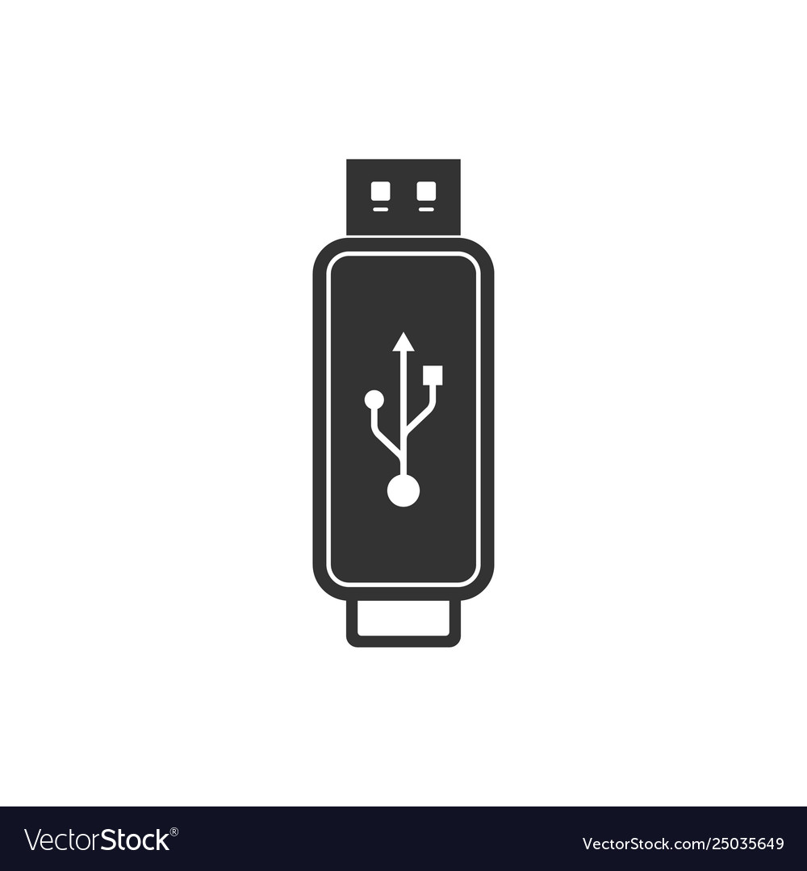



( CH1: Intro )
Problem 2
How to manage sharing the code among your team?

Slide 7

VERSION CONTROL SYSTEM
Features
( CH1: Intro )
A system that is like a database of references that stores all the change that occurred to the code.
Compare changes over time.
See who last modified file to fix bugs.
It allows you to revert selected files back to a previous version.
Revert the entire project back to a previous state

Slide 8
VERSION CONTROL SYSTEMS
( CH1: Intro )
Local
Stores all changes to files only on your computer.

Slide 9
Local Version Control
( CH1: Intro )
A local database located on your local computer, in which every file change is stored as a patch.
Every patch set contains only the changes made to the file since its last version.
Checkout
Version Database
File
Version 3
Version 2
Disadvantages
No Collaboration
Single point of failure
Version 1

Slide 10
VERSION CONTROL SYSTEMS
( CH1: Intro )
Local
Stores all changes to files only on your computer.
Centralized
Only a single central server contains all the versioned files.

Slide 11
Centralized Version Control
( CH1: Intro )
Enables multiple clients to simultaneously access files on the server, pull them to their local computer or push them onto the server from their local computer.
This allows for easy collaboration with other developers or a team.
Administrators have control over who can do what.
Client 1
Central Server
File
Version 1
Client 2
File
Disadvantages
Single point of failure

Slide 12
VERSION CONTROL SYSTEMS
( CH1: Intro )
Local
Distributed
Stores all changes to files only on your computer.
A hybrid system that allows you to have copy on your computer.
Centralized
Only a single central server contains all the versioned files.

Slide 13
Distributed Version Control
( CH1: Intro )
Clients fully mirror the repository, including its entire history, rather than merely viewing the most recent snapshot of the files from the server.
Each person working on a project has a local copy of the entire project, meaning they each have a local database containing their whole history.
With this model, any client repository can send a copy of the project's version to any other client or back onto the server when it becomes available in the event that the server goes down or becomes unavailable.
Repository
push
push
pull
pull
Repository
Repository
commit
commit
update
update
Working copy
Working copy

Slide 14
( CH1: Intro )
Git
An open-source distributed version control system tool that supports distributed non-linear workflows and tracks changes in any set of computer files.
Developed in 2005 by Linus Torvalds, the creator of the Linux .

Slide 15
( CH1: Intro )
Repository
A central storage location for managing and tracking changes in files and directories
Working Tree
A directory (and its files and subdirectories) on your file system that is associated with a repository

Slide 16
File’s States
( CH1: Intro )
You have changed the file but have not committed it to your database (local repo) yet.
Untracked
01
You have chosen a modified file in its current version to go into the next commit.
Staged
02
Tracked
03
The file has been committed into your repository.

Slide 17
( CH1: Intro )
Working Directory
Staging Area
Repository (.git)
Checkout
Stage
Commit

Slide 18
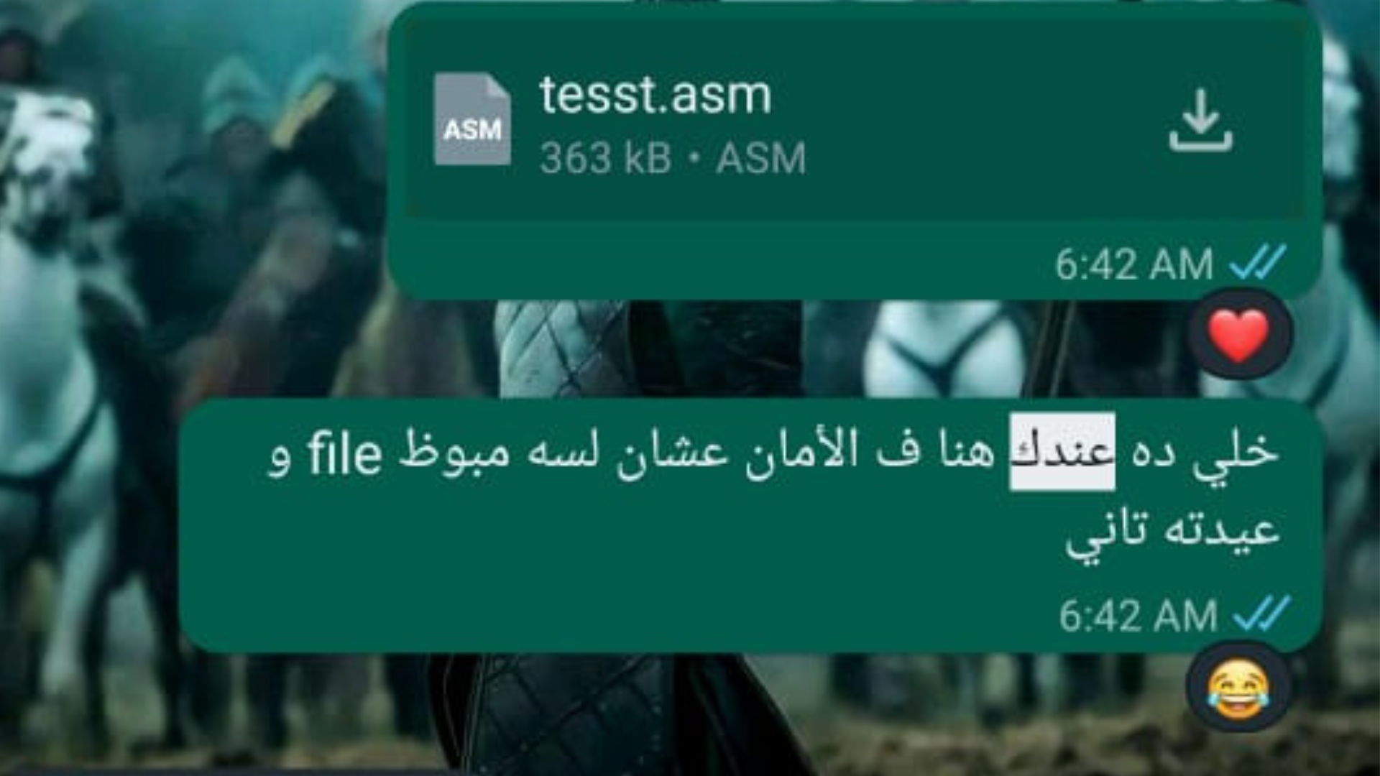
( CH1: Intro )
Git Is Awesome
BUT!!

Slide 19

Let’s make it more Interactive
( CH1: Intro )

Slide 20

Getting Started with Git
GIT WIZARDS

Slide 21
Git Config
(CH2: Basics)
The git config command is a convenience function that is used to set Git configuration values on a global or local project level. These configuration levels correspond to .gitconfig text files. Executing git config will modify a configuration text file.
<section>.<key>

Slide 22
local
global
1
2
system
3
(CH2: Basics)
By default ,git config will write to a local level if no configuration option is passed
Meaning is applied to operating system user
This covers all users on an operating system and all repos.

Slide 23

(CH2: Basics)
Git config --list
Git reads the configuration files and displays the values of all the configuration settings currently in effect.
includes settings such as user.name and user.email, which specify your name and email address to be associated with your Git commits. It can also show other settings like core.editor .

Slide 24
(CH2: Basics)
Git config --global user.name
To retrieve the currently configured global user name
To set your name :
git config –global user.name “your name”

Slide 25
(CH2: Basics)
Git config --global --unset user.name
By using the --unset option, you can remove the globally configured username in Git, effectively unsetting it. Once unset, Git will not associate any commits with that username, unless you provide a different username explicitly in a local repository or set a new global username.

Slide 26

NOTE
(CH2: Basics)
When you initialize Git, it is important to configure your user name and email address

Slide 27
Create a new repo
(CH2: Basics)

Slide 28
Git init
(CH2: Basics)
The git init command creates a new Git repository. It can be used to convert an existing, unversioned project to a Git repository or initialize a new, empty repository. Most other Git commands are not available outside of an initialized repository, so this is usually the first command you'll run in a new project.
Executing git init creates a .git subdirectory in the current working directory, which contains all of the necessary Git metadata for the new repository. This metadata includes subdirectories for objects, refs, and template files. A HEAD file is also created which points to the currently checked out commit

Slide 29
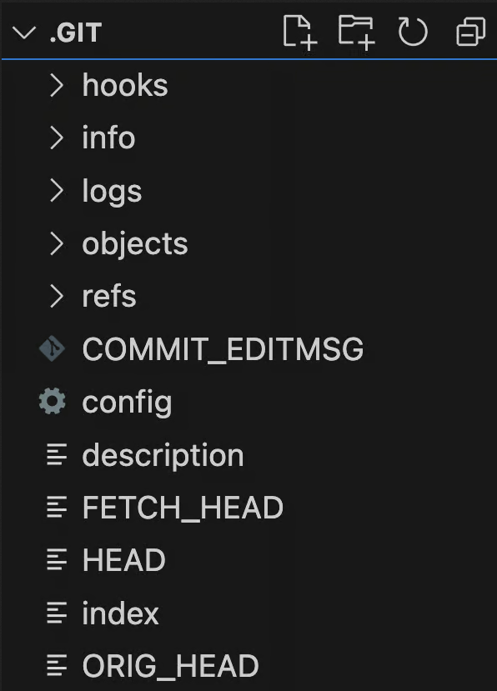
steps
(CH2: Basics)
01
Create a new folder to be the repsitry location .
$ mkdir myfirstrepo
$ cd myfirstrepo
$ git init
02

Slide 30
Git add
(CH2: Basics)
The git add command adds a change in the working directory to the staging area. It tells Git that you want to include updates to a particular file in the next commit. However, git add doesn't really affect the repository in any significant way—changes are not actually recorded until you run
git commit.

Slide 31
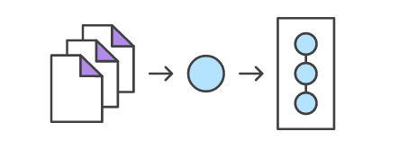
Git commit
(CH2: Basics)
Developing a project revolves around the basic edit/stage/commit pattern. First, you edit your files in the working directory. When you’re ready to save a copy of the current state of the project, you stage changes with git add. After you’re happy with the staged snapshot, you commit it to the project history with git commit. The git reset command is used to undo a commit or staged snapshot.

Slide 32
Git status
(CH2: Basics)
The git status command displays the state of the working directory and the staging area. It lets you see which changes have been staged, which haven’t, and which files aren’t being tracked by Git. Status output does not show you any information regarding the committed project history.

Slide 33
(CH2: Basics)
echo “BATMAN” >> README.md
git status
git commit –m “BATMAN”

Slide 34
Git log
(CH2: Basics)
The git log command displays committed snapshots. It lets you list the project history, filter it, and search for specific changes. While git status lets you inspect the working directory and the staging area, git log only operates on the committed history.

Slide 35
Git log
--oneline
--graph
(CH2: Basics)
shows the commit information on a single line making it easier to browse through commits at-a-glance.
A few useful options to consider. The --graph flag that will draw a text based graph of the commits on the left hand side of the commit messages.

Slide 36

CH3
Decoding Git
(GIT WIZARDS)
Let’s pop the hood and understand what git really is?

Slide 37
To follow along in our jorney
(CH3: Decoding Git)
Rule1: We will pose a riddle
Rule2: Speculate an answer
Rule3: Investigate

Slide 38
Does git care who you are?
(CH3: Decoding Git)
Git care only about one thing the .git folder
Investigation
Make a new dir called xgit and cd it.
Command: git init
Command: git status
Cut the .git folder
Paste it in root dir
Command: git status
.git

Slide 39
Outcomes Of Investigation
(CH3: Decoding Git)
Does git care who you are?
Git's storage model is neutral towards different users. It stores all its state in the .git folder and before executing nearly any command. It goes and find the .git folder to know what to do.It searches in the current working directory and its parents
.git

Slide 40
How git stores its state in .git folder
(CH3: Decoding Git)
Option1: storing diffs between one commit and another.
Option2: storing the entire repo at each commit.
Investigation
.git
Command: git log

Slide 41
(CH3: Decoding Git)
Git refers to each commit with something like this
0c96c651ea67b5d191c5e54460c49a7fd8cf4e07
40 symbol. Each symbol is between a-f and 0-9
Same size for different commits
Hashing: refers to the process of generating a fixed-size output from an input of variable size using the mathematical formulas known as hash functions.
---------------------------------------------------------
One-Way: It's impossible to reverse a hashing process.
----------------------------------------------------------
Non-Locality: In the case of the non-local hash function, similar inputs generate dissimilar outputs.
----------------------------------------------------------

Slide 42
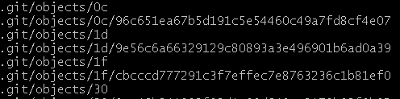
(CH3: Decoding Git)
Let’s look for our commit in the .git
0c96c651ea67b5d191c5e54460c49a7fd8cf4e07
If you try to open these files you will find compressed data.
$>$ So a SHA in git is just a pointer to something

Slide 43
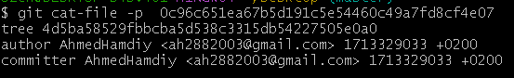
(CH3: Decoding Git)
If you try to open these files you will find compressed data. Let’s uncompress it
Investigation
.git
Command: git cat-file –p 0c96c651ea67b5d191c5e54460c49a7fd8cf4e07
What is in a commit ?
- Meta-data
- Other SHAs

Slide 44
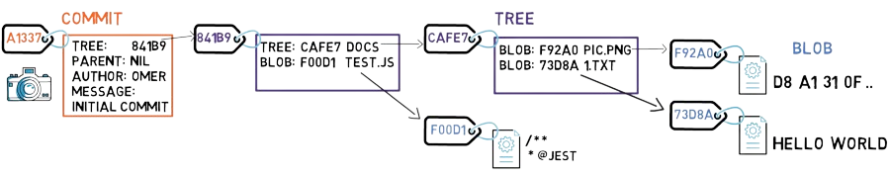
(CH3: Decoding Git)
What these other SHAs refer to
Parent --> The commit that precedes current commit
Tree --> The main directory that the git tracks
$>$ So a commit stores a snapshot of the entire repository.

Slide 45
CH4
Branches
(CH4: BRANCHES)
merge & rebase
Oh, do you really develop everything on main?
That’s a problem.

Slide 46
Branches
(CH4: BRANCHES)
We all know what is a branch but nobody asks why is a branch.
“Branching means you diverge from the main line of development and continue to do work without messing with that main line, to be safe and keep the main safe from you.”

Slide 47
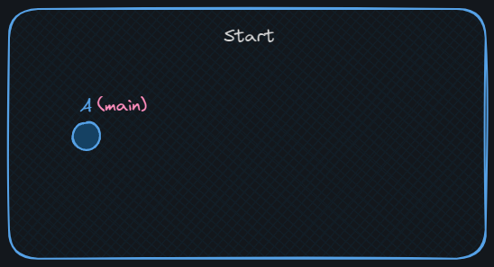
Mission 0
git-branches
(CH4: BRANCHES)
Code your way to succeed
Desired State
Prepare your repo:
Make a new dir called `git-branches`
Make a repo in this dir
Commit A

Slide 48
Mission 0
(CH4: BRANCHES)
Desired State

Slide 49
Mission 0
git-branches
(CH4: BRANCHES)
Great Job! Mission 0 status: done
mkdir git-branches
cd git-branches
git init
touch A
git add .
git commit -m A

Slide 50
Creating branches
To create a new branch:
(CH4: BRANCHES)
git branch <branch-name>
To switch to a branch:
git checkout <branch-name>
⚠️ Attention: after you create a branch git doesn’t automatically switch to it

Slide 51
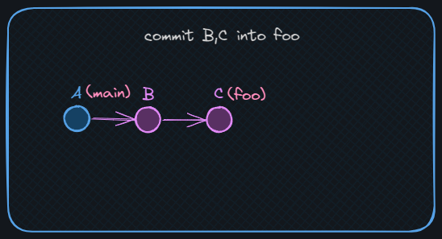
Mission 1
git-branches
(CH4: BRANCHES)
Code your way to succeed
Desired State
Your first branch:
Create a branch “foo” and switch to it.
find foo in .git
Commit “B” and “C” into foo
Note: make the change the same as the commit message

Slide 52
Mission 1
(CH4: BRANCHES)
Desired State

Slide 53
Mission 1
git-branches
(CH4: BRANCHES)
Great Job! Mission 1 status: done
git branch foo
git checkout foo
find .git
# refs/heads/foo
Touch B
git add .
git commit -m B
Touch C
git add .
git commit -m C

Slide 54
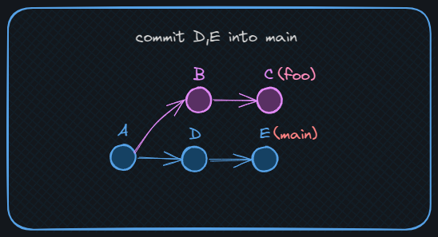
Mission 2
git-branches
(CH4: BRANCHES)
Code your way to succeed
Desired State
Things happen on main, you know:
Switch to main
commit “D” and “E”
NOTE: make sure to commit in a new file
We don’t want conflicts yet 😉

Slide 55
Mission 2
(CH4: BRANCHES)
Desired State

Slide 56
Mission 2
git-branches
(CH4: BRANCHES)
Great Job! Mission 2 status: done
git checkout main
Touch D
git add .
git commit -m D
Touch E
git add .
git commit -m E
git log --graph
--oneline --parents

Slide 57
Combining Your Work:
(CH4: BRANCHES)
In git, there are 2 main ways to join branches:
merge
rebase

Slide 58
(CH4: BRANCHES)
merge
“A merge is attempting to combine two histories together that have diverged at some point in the past. There is a common commit point between the two, this is referred to as the best common ancestor”
- The docs

Slide 59
(CH4: BRANCHES)
merge
To merge a branch into the currently checked branch:
git merge <source-name>
Merge has 2 outcomes depending on the state, more on that later.
⚠️ NOTE: the target-branch is the currently checked branch

Slide 60
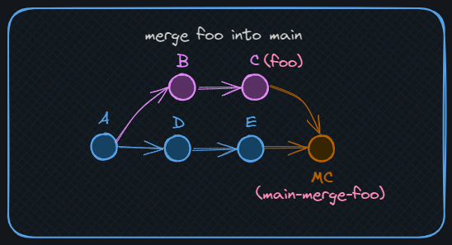
Mission 3
git-branches
(CH4: BRANCHES)
Code your way to succeed
Desired State
Let’s merge:
Create a new branch “main-merge-foo” of main.
Merge foo
Look at the graph

Slide 61
Mission 3
(CH4: BRANCHES)
Desired State

Slide 62
Mission 3
git-branches
(CH4: BRANCHES)
Great Job! Mission 3 status: done
git checkout main
git checkout -b main-merge-foo
git merge foo
git log --graph --oneline --parents

Slide 63
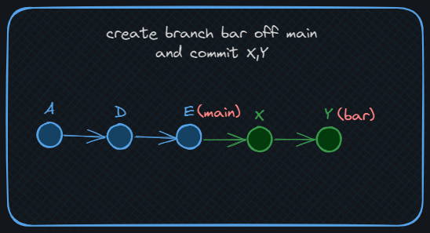
Mission 4
git-branches
(CH4: BRANCHES)
Code your way to succeed
Desired State
Let’s Fast-Forward merge:
Make a new branch “bar” off main.
Commit “X” and “Y”
Merge bar into main

Slide 64
Mission 4
(CH4: BRANCHES)
Desired State

Slide 65
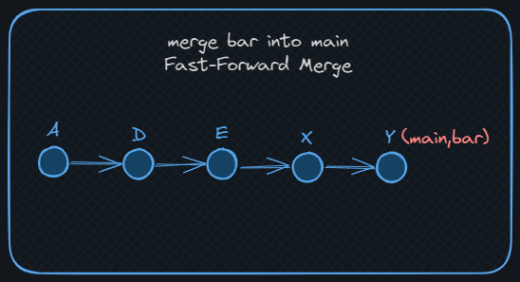
Mission 4
(CH4: BRANCHES)
Desired State

Slide 66
Mission 4
git-branches
(CH4: BRANCHES)
Great Job! Mission 4 status: done
git checkout main
git checkout -b bar
touch X
git add .
git commit -m X
touch Y
git add .
git commit -m Y
git checkout main
git merge bar

Slide 67
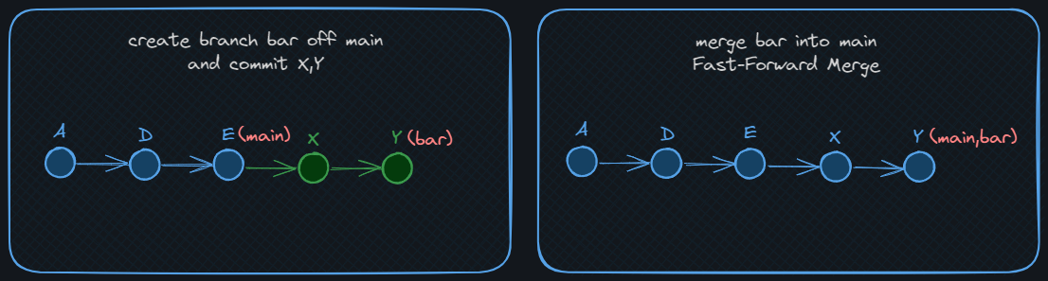
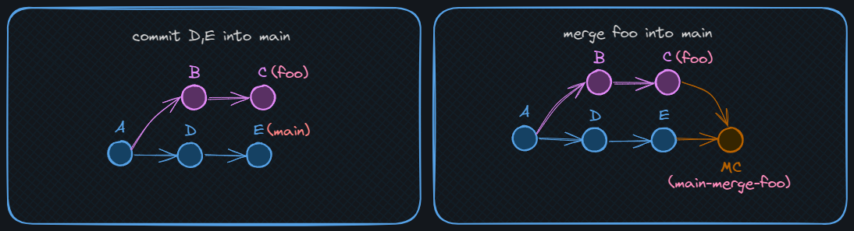
Merge Outcomes:
Fast Forward Merge: just update the pointer/reference (no merge commits)
(CH4: BRANCHES)
Divergence Merge: create a merge commit to combine 2 commits/histories have 2 parents

Slide 68
(CH4: BRANCHES)
rebase
“git-rebase - `Reapply` commits on top of another base tip”
- "the docs"
To rebase a branch:
git rebase <target-branch>
⚠️ NOTE: rebase is often used at your private feature branch, so target-branch is often “main”

Slide 69
(CH4: BRANCHES)
rebase
How rebase works:
checkout the latest commit at `<target-branch>`
replay one commit at a time of the `<source-branch>`
update source branch ref to the latest commit made.
⚠️ NOTE: rebase alters history and creates new commits as commits in git are immutable
Rebase doesn’t create merge-commits.

Slide 70
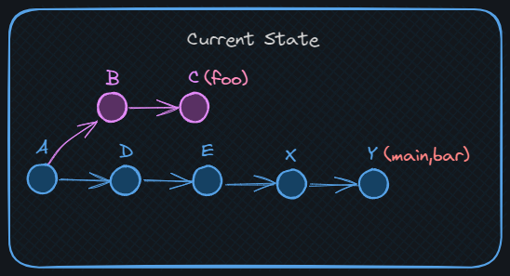
Mission 5: last mission in this chapter
git-branches
(CH4: BRANCHES)
Code your way to succeed
Current State
Rebase Your feature branch:
Checkout foo
Rebase off main

Slide 71
Mission 5
(CH4: BRANCHES)
Current State

Slide 72
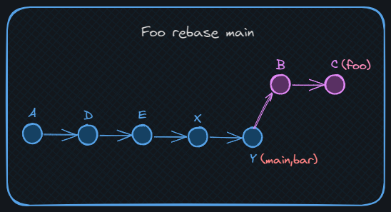
Mission 5
(CH4: BRANCHES)
Desired State

Slide 73
Mission 5: last mission in this chapter
git-branches
(CH4: BRANCHES)
Great Job! Mission 4 status: done
git checkout foo
git rebase main
git log --graph --oneline

Slide 74
Merge VS. Rebase
Merge
Rebase
(CH4: BRANCHES)
doesn't alter history 👍
👍 no annoying merge commits
doesn't require push force👍
👍 linear history which is easier to search
works with private and👍 ‘public branches
👎 alters history
makes annoying merge👎 commits
👎 requires `push force`

Slide 75

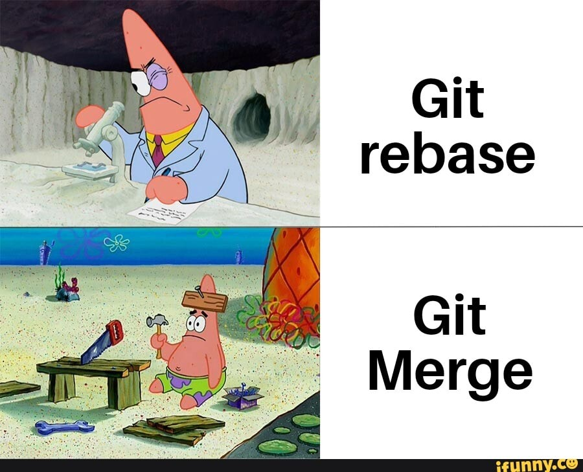
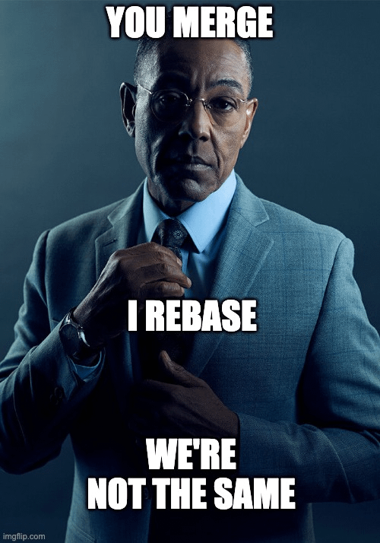
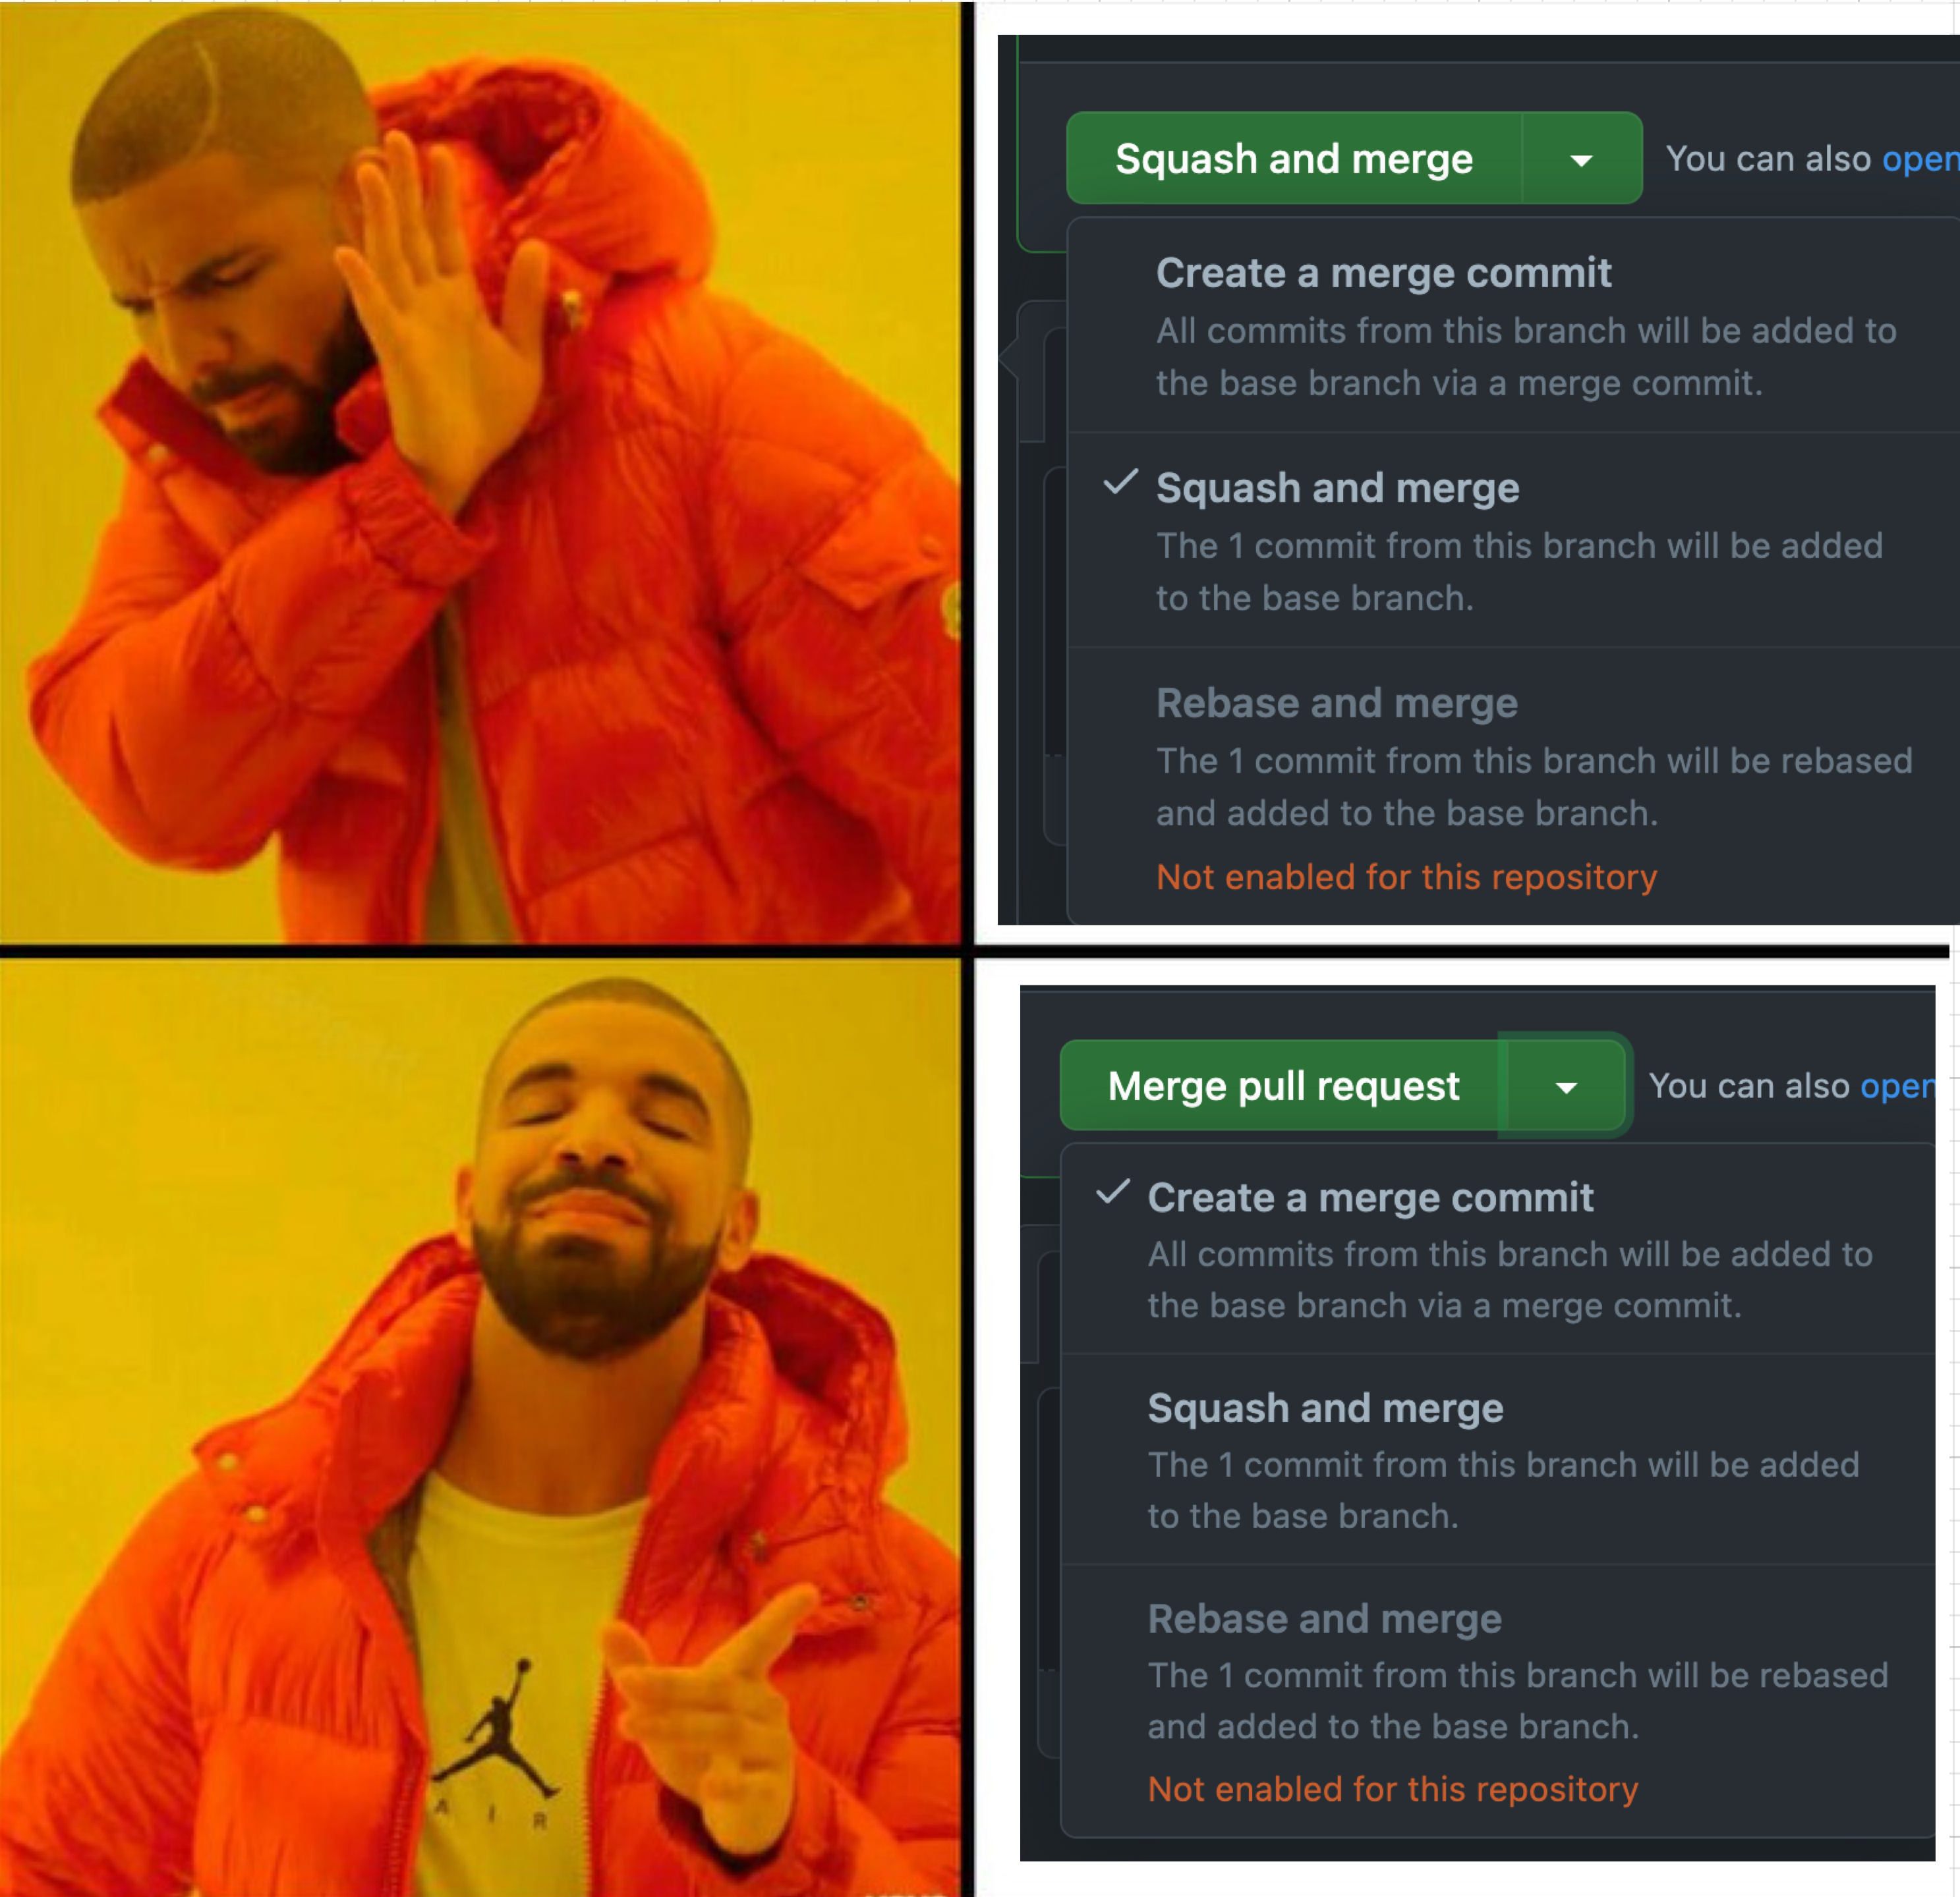
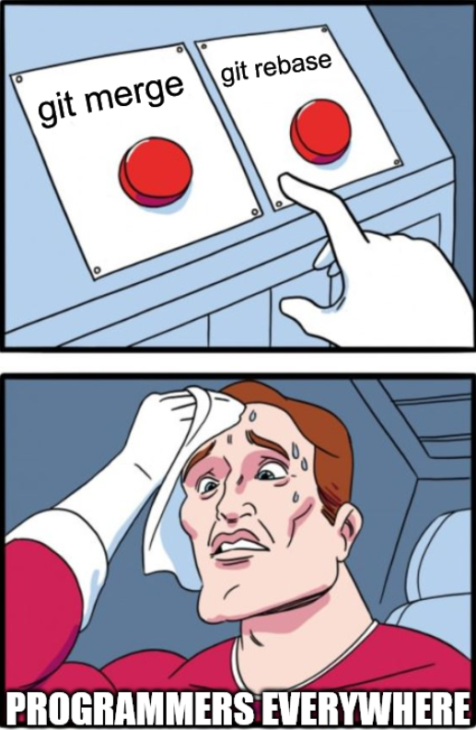
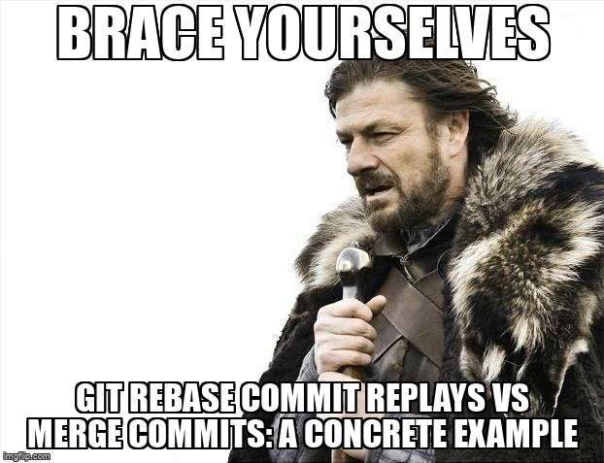
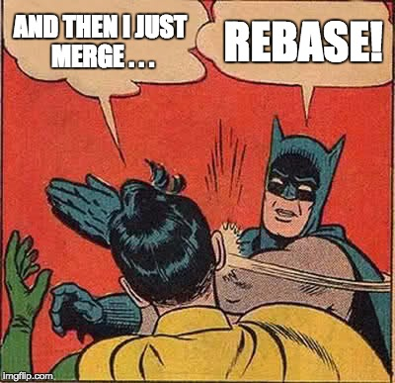
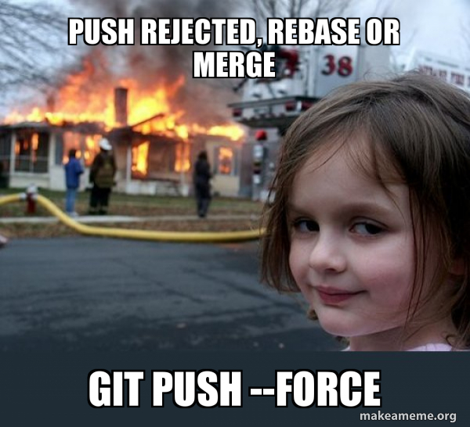

Workflows Wars
(CH4: BRANCHES)

Slide 76
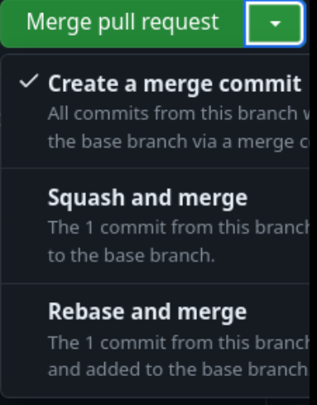
Workflow wars
Merge Workflows (just merge)
(CH4: BRANCHES)
Rebase flow (rebase in private - FF merge in public)
ℹ️ merge back into main
👎 annoying merge commits
ℹ️rebase main into your branch first, then fast forward merge into main
⚠️ NOTE1: people are always so opinionated about which workflow is better, but rebase is diffidently the best 😉
⚠️ NOTE2: the difference between the 2 flows in simple form compiles to which option you choose in GitHub pull request.

Slide 77
What is HEAD?
CH5
(GIT WIZARDS)
(HEAD -> main)

Slide 78
HEAD
( CH5: HEAD & Reflog )
Is a reference variable in git. It points to the tip of your current branch.

Slide 79
Like everything, it’s stored inside .git/
( CH5: HEAD & Reflog )
Find it inside .git/HEAD
The content is simply a reference to the tip of your current branch (e.g. refs/heads/main).
The “tip of a branch” is the latest commit made on that branch. It is stored inside .git/ as a SHA.

Slide 80
Great concept. What can we do with it?
( CH5: HEAD & Reflog )

Slide 81
Git Reflog
( CH5: HEAD & Reflog )
01
Git stores the full history of HEAD’s movements.
When you switch from branch to branch or make new commits, it records it. Commits are stored as SHAs.
02
03
Everything is recorded, all the way back to git init!

Slide 82
How can git reflog be a powerful feature?
CH5. HEAD & Reflog

Slide 83
One example is restoring commits!
A. Through merging
( CH5: HEAD & Reflog )
Even if a branch gets deleted, its commits remain recorded in reflog. This means you can run git merge <SHA> and have your commits back.

Slide 84
One example is restoring commits!
B. You could also cherry-pick!
( CH5: HEAD & Reflog )
If merging becomes too problematic, you can cherry-pick instead! Cherry-picking a commit means merging only the changes this commit introduces, and none of its previous history.
Git cherry-pick <SHA>

Slide 85
CH6
Remote
( CH6: REMOTE )
Are you ready to deal with the outside world?

Slide 86
( CH6: REMOTE )
What’s remote?
Have you thought about GitHub on hearing “remote”?
Remote repositories are versions of your project somewhere else.
NOTE:
Remote repositories can be on your local machine.
It is entirely possible that you can be working
with a “remote” repository that is on the same host you are.
Remote does not necessarily imply that the repository is somewhere else on the network or Internet, only that it is elsewhere.

Slide 87

In summary, going remote doesn’t necessarily mean using GitHub. GitHub is used with git for online backup and collaborating with others.
( CH6: REMOTE )
GitHub
⚠️ Throughout this chapter we’ll act like we’re using GitHub, but we’ll actually use a remote repo in our local machine ( same concepts are applied to GitHub ).
We can link our local repo with a remote one Using:

Slide 88
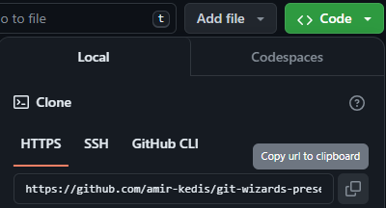
Git remote
( CH6: REMOTE )
01
Using git remote
git init
git remote add <remote> <url>
02
Using git clone
Note:
Using git clone creates a folder with git initialized in it. No need for git init.
Specifying the folder name is optional.
git clone <url> <folder-name>

Slide 89
TODO: Create a new repo and add git-branches as its remote…
( CH6: REMOTE )
mkdir local
cd ./local
git init
git remote add origin ../git-branches
git remote -v
NOTE:
git remote –v to list out your remotes and their locations.

Slide 90
Git fetch
Git fetch
( CH6: REMOTE )
What happens when you fetch?
Git contacts the remote repository.
Retrieves any new commits, branches that exists in the remote repo and doesn’t exist in your local one.
Updates your local repository’s remote-tracking branches to reflect the remote repo state

Slide 91
Git fetch
Git fetch
( CH6: REMOTE )
In summary:
fetch is used to update all the remote tracking branches as they are not updated automatically.
However, the command does not:
Change the state of your current working branches.
Merge any changes into your local branches.
Modify any of your local files or commit history.
Note:
You can use git merge to merge the updates.

Slide 92
Git pull
( CH6: REMOTE )
You can use pull instead of fetching then merge to merge the remote changes into your local branch.
All you need to do is just:
git pull <remote> <branch>
Note:
git pull is a combination of git fetch and git merge.

Slide 93
TODO: Fetch the changes from remote repo then pull them
( CH6: REMOTE )
git fetch
git branch -a
git pull origin main
Notice how state didn’t change on fetching

Slide 94
Git push
( CH6: REMOTE )
What if you’re the one who made changes and want to make it visible in the remote repo
Just the opposite of pull
git push <remote> <branch>

Slide 95
TODO: Create a new commit in local repo then push it to remote
( CH6: REMOTE )
git branch local
git checkout local
echo “local changes” >> README.md
git add .
git commit –m “local updates”
git push origin local

Slide 96
TODO: Create a new commit in both repos where both change README.md last line with:
( CH6: REMOTE )
Hello from local
Hello from remote
vim README.md
git add .
git commit –m ”local”
git pull origin main
vim README.md
git add .
git commit –m ”local”
local
remote

Slide 97
Merge Conflicts
( CH6: REMOTE )
local
remote
Hello from local
Hello from remote
CONFLICT (content): Merge conflict in README.md Automatic merge failed; fix conflicts and then commit the result.
Merge conflicts happens when git cannot automatically merge (e.g., Making different changes in the same line of the same File)

Slide 98
File With Conflicts
( CH6: REMOTE )
<<<<<<< HEAD
Hello from local
=======
Hello from remote >>>>>>> 3481fb2d429347f009646b1456375e6685c1a36e
Any >>>>, =====, <<<<< denote parts of the conflict.
<<<<<<< HEAD
This states that HEAD’s conflicted change starts here and continues until the ===== line.
==== denotes the separation of the two merges.
.
The end of the merge conflict is denoted with >>>> and the SHA of the incoming conflicted change.

Slide 99
To Resolve Merge Conflicts:
( CH6: REMOTE )
You just need to remove the lines starting with >>>>>>
And ======
And either:
01
Accept local (current) changes
02
Accept remote changes
03
Combine both
04
Add completely different changes

Slide 100
Fancy Git Commands
CH7
( CH7: Fancy Git )
Re-writing History As You Wish.

Slide 101
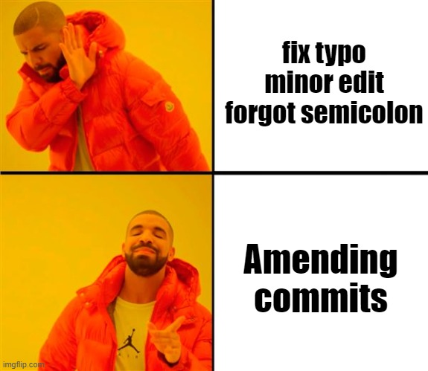
Amending Commits
(CH7: Fancy Git)

Slide 102
Amending (editing) Commits
( CH7: Fancy Git )
01
Make the edit you forgot
02
Stage it
03
Now, instead of creating a new commit, you can edit (amend) the last commit directly

Slide 103
Try it yourself
( CH7: Fancy Git )
Ex1: Make a wrong commit, then fix this same commmit
echo “I don’t love you” > cmp.md
git add .
git commit –m “confession”
# realize you were wrong ..
# how to fix it ?
echo “I love you” > cmp.md
git commit --amend --no-edit
You can check before & after using git log
Amend

Slide 104
Interactive rebase
( CH7: Fancy Git )
Edit History (not just the last commit)
You can do these and more..
Change order of commits
Amend (edit) older commits
Squash (combine) commits
Delete commits
….

Slide 105
How to start an interactive rebase?
( CH7: Fancy Git )
View log to understand
Count commits back from head that you want to edit
Then ,…
git rebase -i HEAD~n
Where n is the number of commits back from HEAD to edit.

Slide 106
Try it yourself
( CH7: Fancy Git )
Ex2: commit 4 changes ‘A’ ‘B’ ‘C’ ‘D’ to a file
echo A >> hello.md
git add .
git commit –m “A”
# repeat for B, C, D
git log --oneline
git rebase -i HEAD~4
rebase -i

Slide 107
Reword, Reorder, Squash
( CH7: Fancy Git )
No boring sildes here.
Let’s do it together,
Don’t be lazy

Slide 108
Stash
( CH7: Fancy Git )
01
You made some changes
You don’t want to commit yet, and you don’t want to lose them
02
03
Stash them for now (Something like Add to watch later)

Slide 109
Stash
( CH7: Fancy Git )
git stash
(OR)
git stash -m “draft”
Push
To add an entry
(changes must be saged first)
Pop
git stash pop
To retrieve an entry
Drop
git stash drop
Drop one element
Clear
git stash clear
Clear Everything

Slide 110
Stash
( CH7: Fancy Git )
⚠️ Attention
⚠️Adding changes to stash removes them from the working tree (currently used files)
⚠️ git stash pop
may produce conflicts!
It changes your local files
and removes the selected entry from stash

Slide 111

Undo: Revert / Reset
( CH7: Fancy Git )

Slide 112
Revert vs Reset
Revert
Reset
( CH7: Fancy Git )
Does not create a new commit
Typically used for private branches
deletes the mistake
Creates another commit
Typically used for public branches
covers the mistake

Slide 113
Reset soft vs hard
reset --soft
reset --hard
( CH7: Fancy Git )
commits are deleted
working tree is checked out to the last commit
commit are deleted
their changes in the working tree are preserved

Slide 114
Tools & More
( CH8: Tools & More)
CH8
Faster Workflows and more to look for

Slide 115
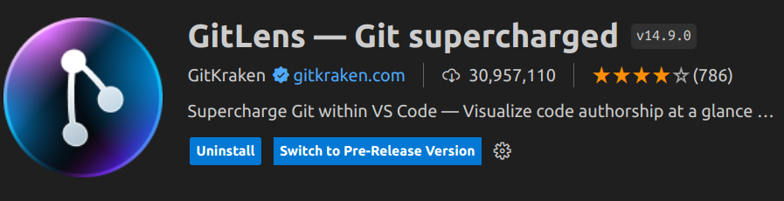

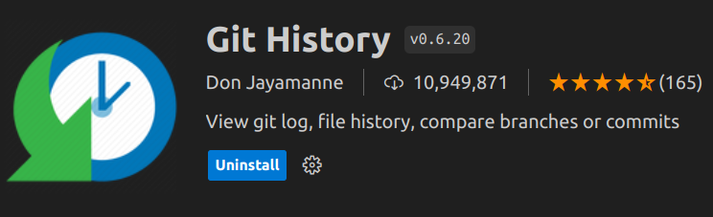
Lazygit, and more alternatives
( CH8: Tools & More)

Slide 116
Tags & releases
( CH8: Tools & More)
Tag: Mark a specific point (commit) in history
GitHub Release: Publish a tag to the world

Slide 117
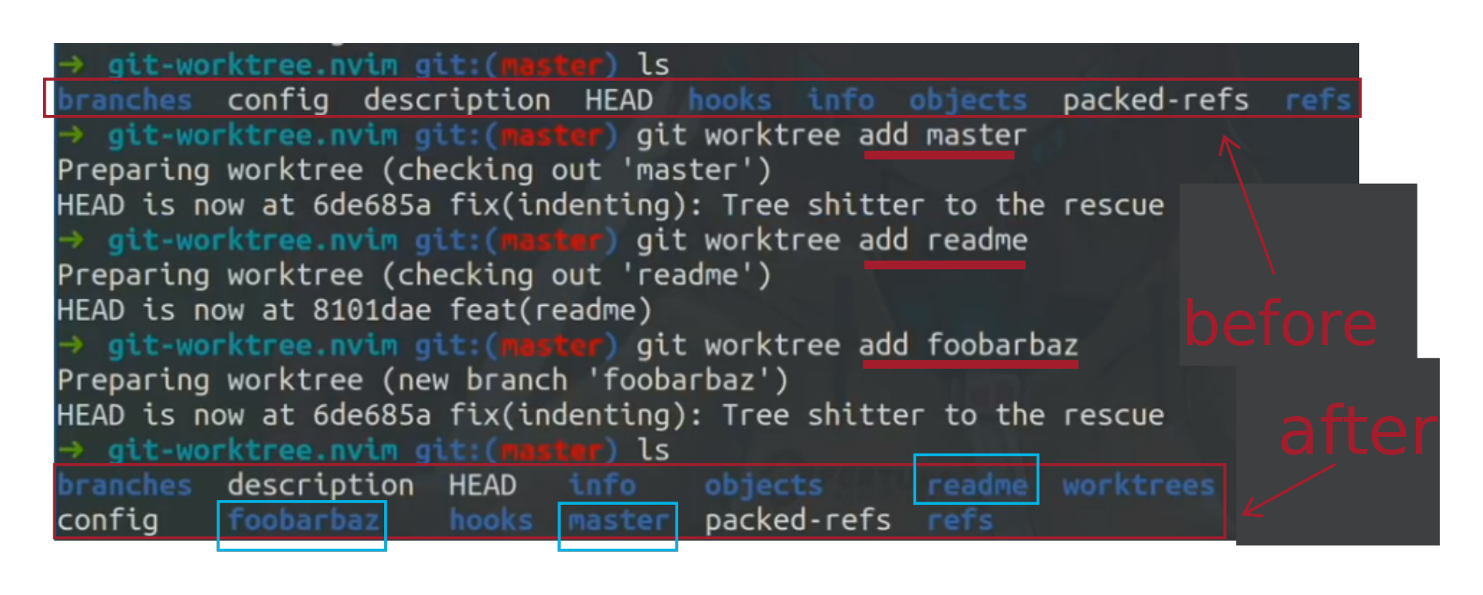
Worktrees
( CH8: Tools & More)

Slide 118
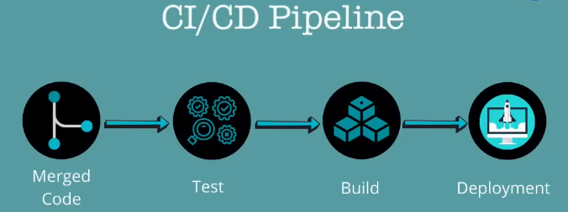
Workflows & GitHub Actions
( CH8: Tools & More)

Slide 119
Thanks!
( SPECIAL EFFECTS )
Do you have any questions?

Slide 120
Quiz
GIT WIZARDS
1. Git is a ...... Version control system.
A. Distributed B. Central C. Local D. None
2. What happens when you use git add on a file that is already staged?
A. The file is unstaged B. Nothing, the file remains staged
C. The file is deleted from the repository D. The file is committed immediately
3. How does git internally represent a branch?
A. A separate copy of the entire repo
B. A light-weight pointer to a specific commit
C. A special file containing all changes made on that branch
D. Git doesn’t support branching. This is a GitHub feature
4. Merge has ….. outcomes
A. Just 1 outcome B. 2 outcomes (fast forward, divergence)
C. 2 outcomes (rebase, merge) D. 3 outcomes or more

Slide 121
Quiz
GIT WIZARDS
5. ……….. alters history.
A. Rebase B. Merge C. Push D. Nothing alters history in Git
6. This command shows you the full history of HEAD’s movements through branches and commits.
A. Git reflog B. Git revert
C. Git pull --rebase D. Git config --get-regexp <branch>
7. What is the command to get all the change history of a remote repository?
A. git add remote B. git fetch
C. git merge D. git push

Slide 122
Quiz
GIT WIZARDS
8. What will the *git remote -v* command print in the terminal?
A. The current git version you’re running
B. A list of remote repositories and their Urls
C. The last 5 git versions you've installed
D. An inline editor for modifying remote repositories
9. To edit the last commit without creating a new one, you can use:
A. git commit B. git commit --amend
C. git amend D. git revert
10. What is the purpose of creating tags in Git?
A. To mark specific points in the Git history for future reference
B. To create a new branch from a specific commit
C. To undo the effects of a commit
D. To temporarily save changes from the working directory

